Slide 1

Hospital Management System – Backend

Slide 2





Team Members
Mohamed Atia
Mohamed El-Gazar
Mohamed Khaled
Mohamed El-Abady
Moamen El-Sha3rawy

Slide 3






Project Goal
Build a secure and scalable RESTful API to manage hospital operations such as patients, doctors, appointments, and medical records.
Secure
Protected patient data
Scalable
Handles growing hospital needs
Comprehensive
Complete hospital operations management

Slide 4

Technologies and System Architecture
Technology Stack
System Layers
ASP.NET Core (Backend Framework)
Controller: Handles HTTP requests
SQL Server (Database)
Service: Contains business logic
Entity Framework Core (ORM)
Repository: Handles database access
JWT (Authentication)
Postman and Swagger (Testing and Documentation)
Database: Stores persistent hospital data
GitHub (Version Control)

Slide 5
Database Schema
Main Entities
Patient
Doctor
Appointment
Name, Email, Password, Date of Birth, Contact, Address, Insurance, Emergency Contact
Name, Email, Password, Specialty, Hourly Pay, Experience, Contact
Date, Reason for Visit
Linked to: Patient ID, Doctor ID
Related to: Appointments, Medical Records, DoctorPatients
Related to: Appointments, DoctorPatients
Medical Record
DoctorPatient (Join Table)
Record Date, Diagnosis, Treatment, Notes
Doctor ID, Patient ID, Rating
Linked to: Patient ID
Relationships
One-to-Many: Patient to Appointments
One-to-Many: Doctor to Appointments
One-to-Many: Patient to Medical Records
Many-to-Many: Doctor and Patient (via DoctorPatient)

Slide 6

Key Features
JWT-based authentication
CRUD Operations
Secure authentication system for doctors and patients
Full Create, Read, Update, Delete operations for doctors and patients
Appointment Scheduling
Medical History
Appointment scheduling with validations
Patient medical history management
Data Integrity
Data integrity enforced through model validation

Slide 7
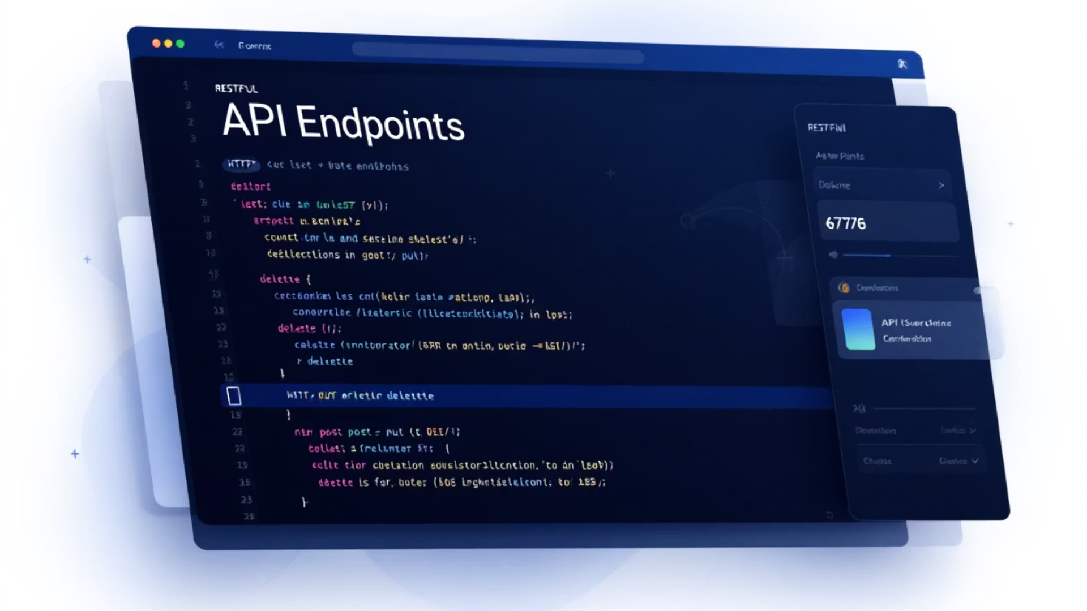
API Endpoints
Patients
Doctors
GET api/patients
GET api/doctors
POST api/patients
POST api/doctors
PUT api/patients/{id}
PUT api/doctors/{id}
DELETE api/patients/{id}
DELETE api/doctors/{id}
Appointments
Medical Records
GET api/appointments
GET api/medicalrecords
POST api/appointments
POST api/medicalrecords
PUT api/appointments/{id}
PUT api/medicalrecords/{id}
DELETE api/appointments/{id}
DELETE api/medicalrecords/{id}

Slide 8

Authentication Workflow
Authorization
Token Generation
Protected routes are enabled using authentication and authorization middleware
User Login
Generate JWT token after successful authentication
Validate user credentials (doctor or patient)
JWT token is passed in request headers for secure access

Slide 9








Testing and Validation
Testing Tools
Authentication Tests
Postman for request testing and Swagger for documentation
Authenticated versus unauthenticated access
Conflict Resolution
Validation Tests
Conflict resolution (e.g. overlapping appointments)
Missing or invalid fields
Building the backend that empowers tomorrow's healthcare.

Slide 10
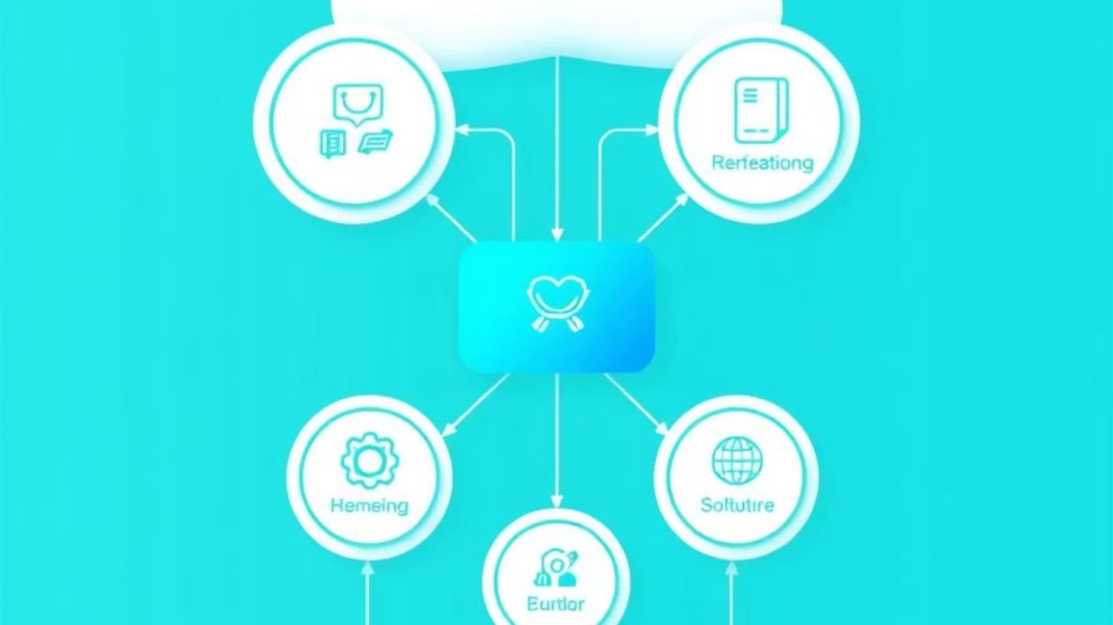
Healthcare System Architecture and API Documentation
Overview of system architecture (Controller → Service → Repo → DB → API).

Slide 11
Entity Relationship Diagram
Patient
Doctor
Appointment
Primary entity storing patient information
Primary entity storing doctor information
Relationship between patients and doctors
Medical Record
DoctorPatient
Patient health documentation
Many-to-many relationship mapping

Slide 12
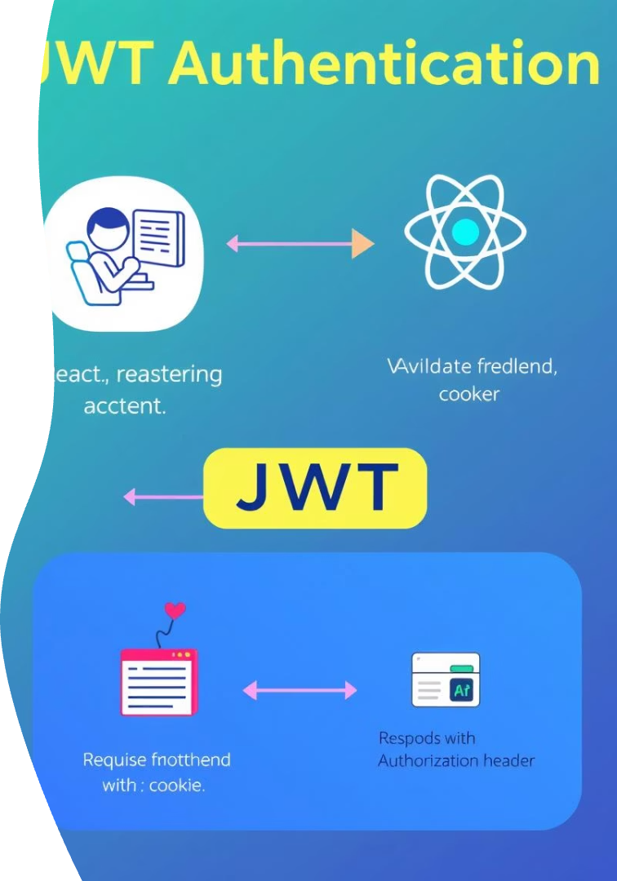




Authentication and Authorization Workflow
User Login
Credentials submitted to backend
JWT Generation
Backend validates and issues token
Token Storage
Frontend stores JWT securely
API Access
Token sent with each request

Slide 13
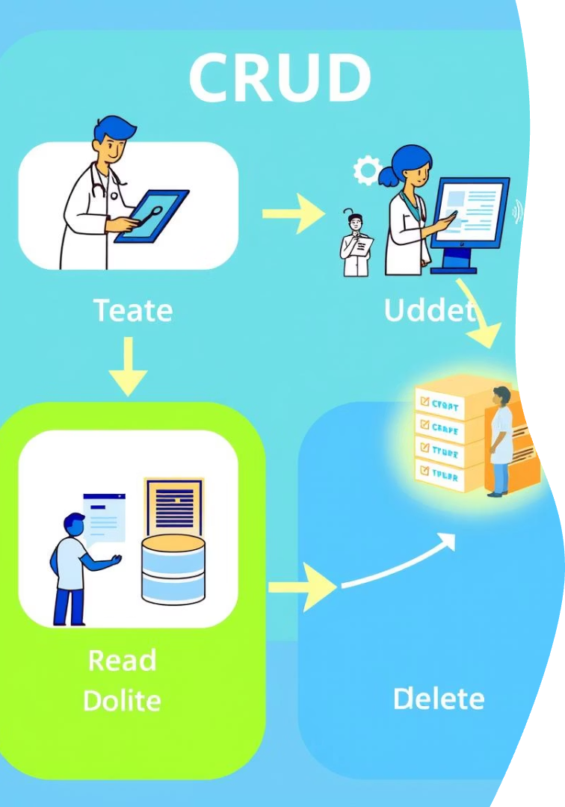
CRUD Operations
Entity
Create
Read
Update
Delete
Patients
✓
✓
✓
✓
Doctors
✓
✓
✓
✓
Appointments
✓
✓
✓
✓
Medical Records
✓
✓
✓
✓

Slide 14







Patient API Endpoints
GET /Patient/{id}/records
GET /Patient/{id}/appointments
Get all medical records for a patient
Get all appointments for a patient
GET /Patient/Filter
POST /Patient/{id}/assign-doctor/{doctorId}
Filter patients by name or criteria
Assign a doctor to a patient
POST /Patient/{id}/rate-doctor/{doctorId}
GET /Patient/{id}/doctors
Rate a doctor
Get doctors linked to a patient

Slide 15
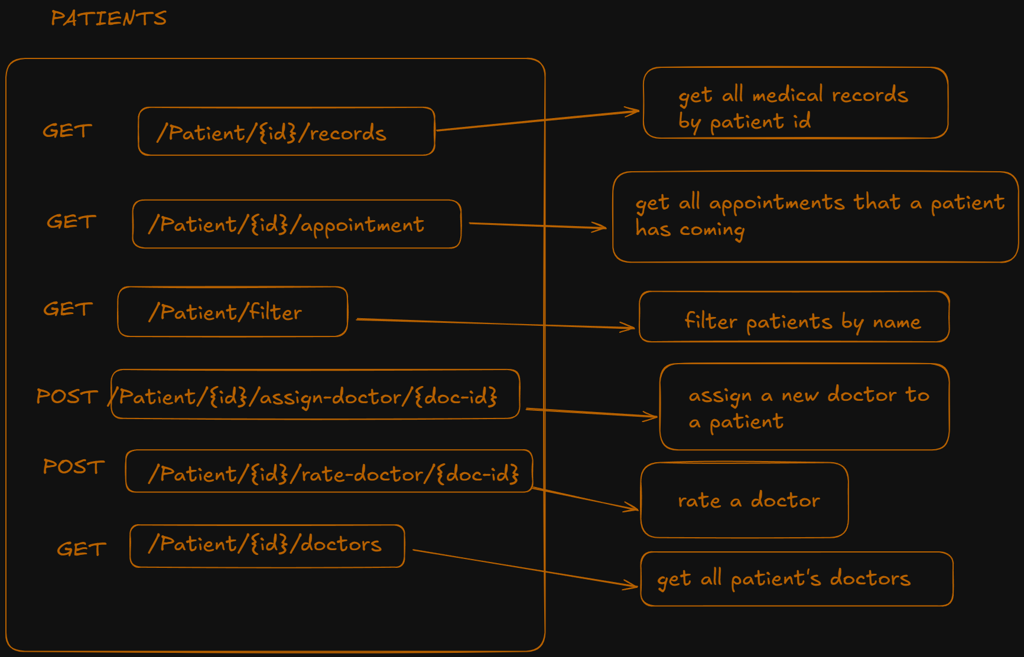

Slide 16









Doctor API Endpoints
GET /Doctor/{id}/patients
GET /Doctor/{id}/appointments
GET /Doctor/{id}/rating/patient/{pid}
GET /Doctor/{id}/rating/summary
Get all patients under a doctor
Get doctor's appointments
Rating given by a specific patient
Doctor rating summary
GET /Doctor/Filter
GET /Doctor/{id}/rating
GET /Doctor/{id}/rating/average
GET /Doctor/{id}/income?date=
Filter doctors by specialty or years of experience
Get doctor's average rating
Average doctor rating
Get doctor's income on a specific date

Slide 17
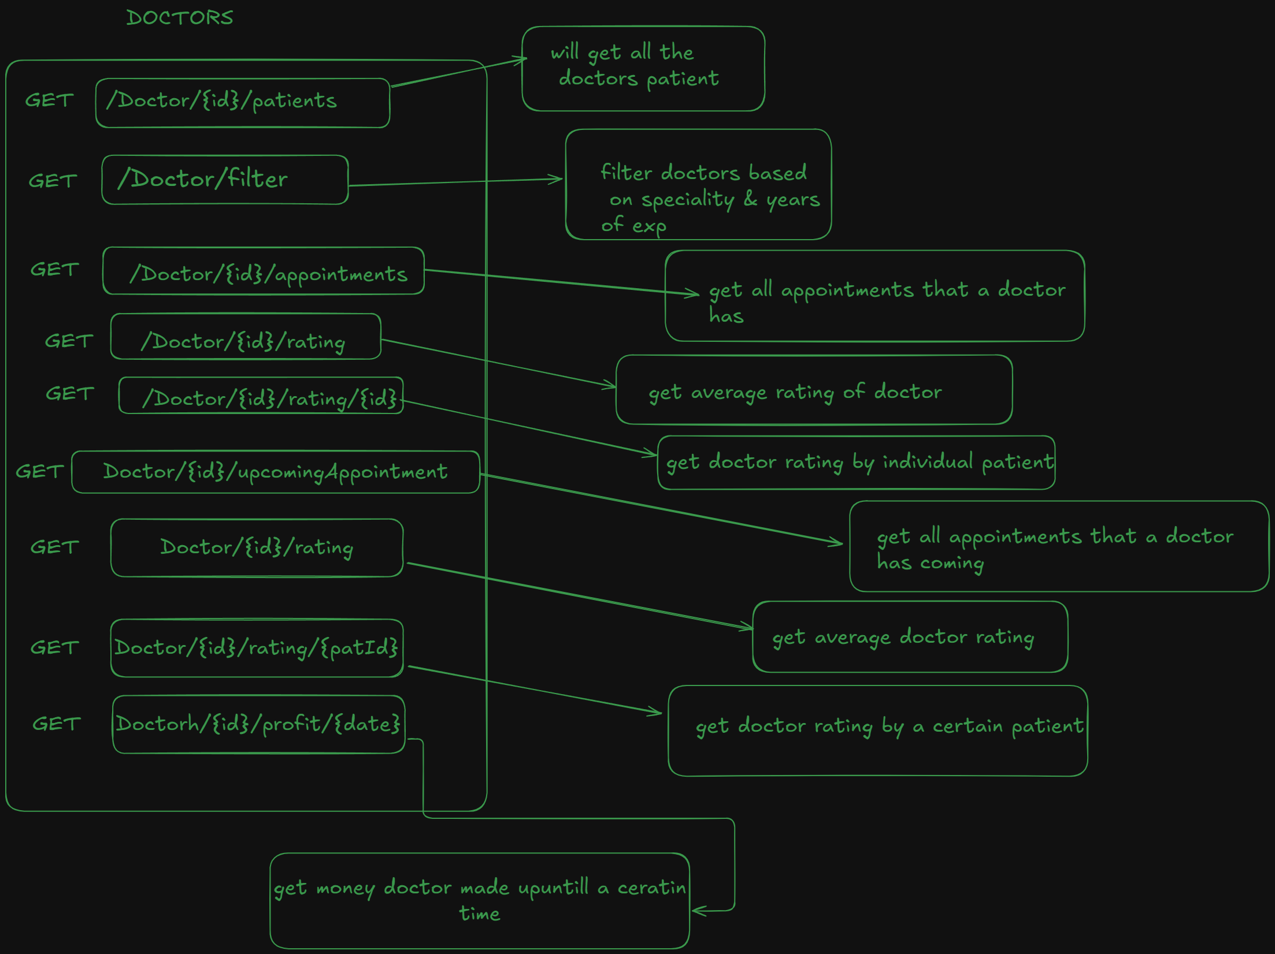

Slide 18


Medical Records API
GET /Medical-records/diagnosis/{keyword}
Get records filtered by diagnosis
Allows searching by specific medical conditions
Returns matching patient records
Supports partial keyword matching
GET /Medical-records/by-date-range
Get records filtered by date range
Supports filtering by start and end dates
Returns chronologically ordered results
Useful for periodic reporting

Slide 19
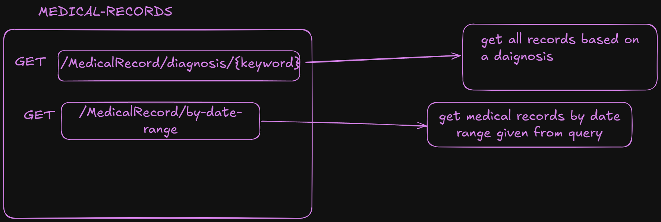

Slide 20




Appointments API
PUT /appointments/{id}/reschedule
GET /appointments/today
Reschedule an appointment
Get today's appointments
Updates appointment time and date
Returns all appointments scheduled for current date
Sends notifications to affected parties
Can be filtered by doctor or facility
Maintains appointment history
Includes patient and time information

Slide 21
